Slide 1
Activity Planning
SPM
UNIT 4

Slide 2

Project Time Management

Slide 3
Importance of Project Schedules
Managers often cite delivering projects on time as one of their biggest challenges
Time has the least amount of flexibility; it passes no matter what happens on a project
Schedule issues are the main reason for conflicts on projects, especially during the second half of projects

Slide 4
Activity planning
Activity refers to the task to be done during the project.
Activity planning is working on the schedule of the project.
It begins with WBS.
Activity planning breaks down into two process.
Defining activities
Sequencing activities

Slide 5
Objectives of activity planning.
Feasibility assessment
Is the project possible within required timescales and resource constraints?
Resource Allocation
What are the most effective ways of allocating resources to the project?
Detailed costing
How much will the project cost and when is that expenditure will take place?

Slide 6
Motivation
Providing targets and monitoring achievement against targets is an effective way of motivating staff, particularly where they have been involved in setting those targets in the first place.
Co-ordination
When do the staff in different departments need to be available to work on a particular project and when do staff need to be transferred between projects?

Slide 7
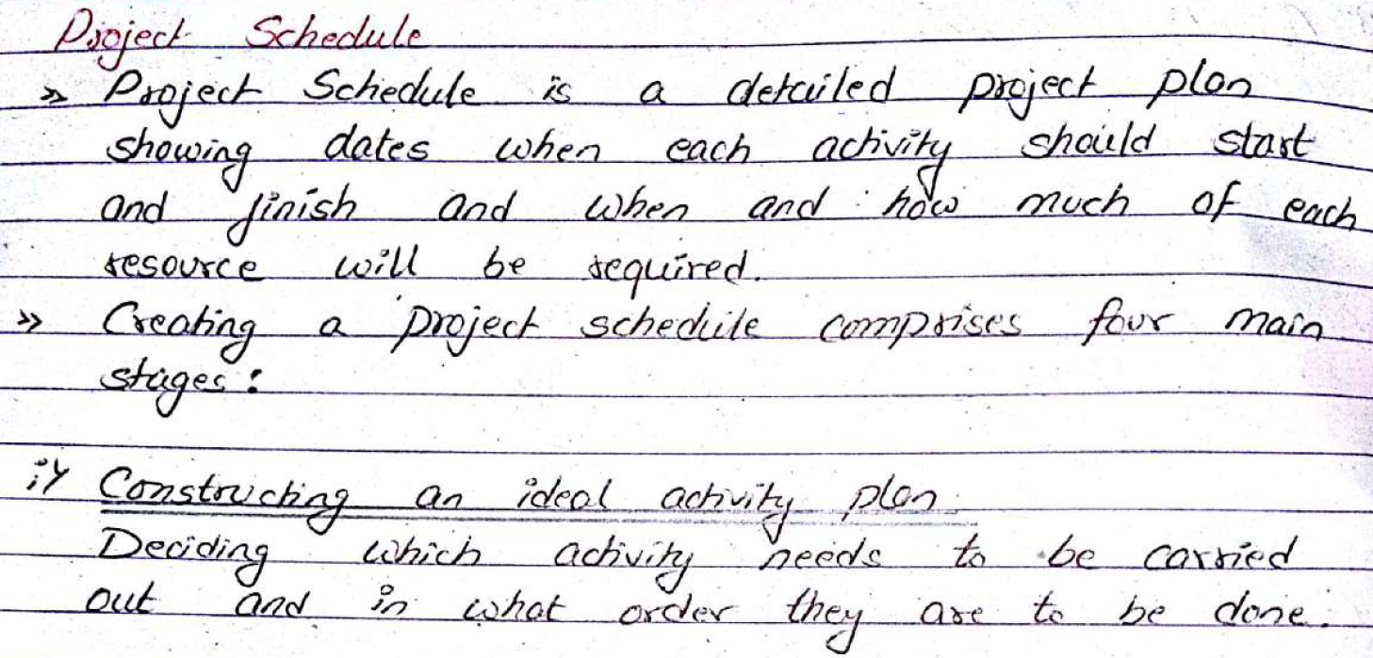

Slide 8
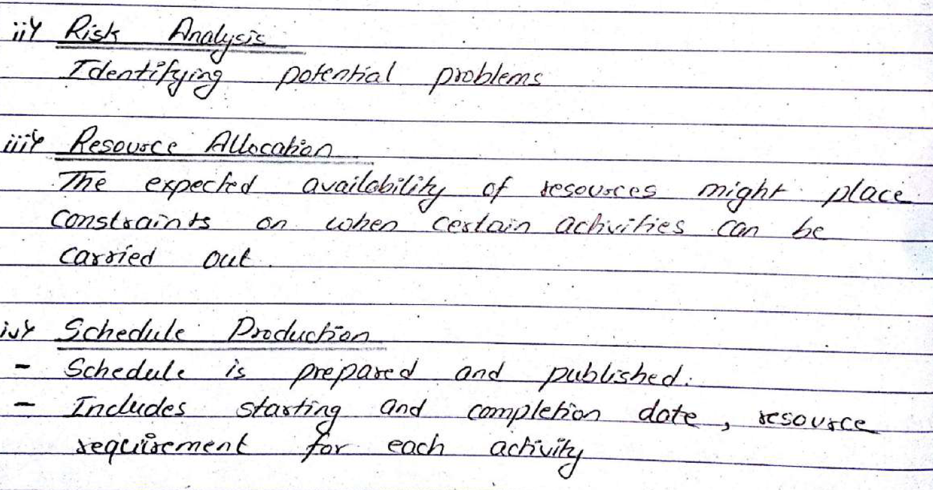

Slide 9
Activity Definition
An activity or task is an element of work normally found on the WBS that has an expected duration, a cost, and resource requirements.
The project charter includes start and end dates and budget information.
The scope statement and WBS help define what will be done.

Slide 10
Activity definition involves developing a more detailed WBS and supporting explanations to understand all the work to be done, so you can develop realistic cost and duration estimates.

Slide 11
Activity Attributes
An activity list is a tabulation of activities to be included on a project schedule. The list should include:
The activity name
An activity identifier or number
A brief description of the activity

Slide 12
Activity attributes provide more information about each activity, such as predecessors, successors, logical relationships, resource requirements, constraints, enforced dates, and assumptions related to the activity.

Slide 13
Identifying Activities
Essentially there are three approaches to identify activities that make up a project.
Activity based Approach
Product based Approach
Hybrid approach.

Slide 14
The Activity Based Approach
Consists of creating a list of all the activities that the project is thought to involve.
While listing activities for a large project, it might be helpful to subdivide the project into subtasks using a Work Breakdown Structure(WBS)
Notes:
WhenpreparingaWBS,considerationmustbegiventothefinallevelofdetailordepthofthestructure.
•Toogreatdepthwillresultinalargenumberofsmalltasksthatwillbedifficulttomanage.
•Tooshallowstructurewillprovideinsufficientdetailforprojectcontrol.
•Eachbranchshould,however,bebrokendownatleasttoalevelwhereeachleafmaybeassignedtoanindividualorresponsiblesectionwithintheorganization.

Slide 15
The Product Based Approach
The PFD indicates, for each product, which other products are required as inputs
The PFD can easily be transformed into an ordered list of activities.
Is particularly appropriate for SSADM which clearly specifies, for each step, each of the products required and the activities required to produce it.
Notes:
Consists of a Product Breakdown Structure(PBS) and a Product Flow Diagram(PFD).
Structured systems analysis and design method(SSADM) SSADM is a waterfall method for the analysis and design of information systems.
SSADM techniques
The three most important techniques that are used in SSADM are as follows:
Logical Data Modelling The process of identifying, modelling and documenting the data requirements of the system being designed. The result is a data model containing entities (things about which a business needs to record information), attributes (facts about the entities) and relationships (associations between the entities). Data Flow Modelling The process of identifying, modelling and documenting how data moves around an information system. Data Flow Modeling examines processes (activities that transform data from one form to another), data stores (the holding areas for data), external entities (what sends data into a system or receives data from a system), and data flows (routes by which data can flow). Entity Event Modelling A two-stranded process: Entity Behavior Modelling, identifying, modelling and documenting the events that affect each entity and the sequence (or life history) in which these events occur, and Event Modelling, designing for each event the process to coordinate entity life histories.

Slide 16
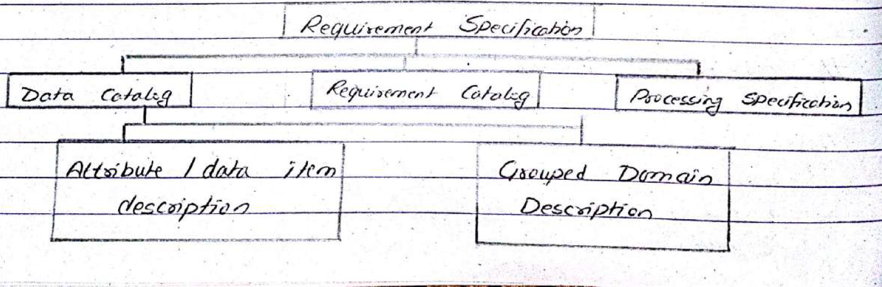

Slide 17
The Hybrid Approach
IBM recommended 5 levels in WBS
Level1: Project
Level2: Deliverables such as software, manuals and training courses
Level3: Components which are the key work items needed to produce deliverables such as the modules and tests required to produce the system software.
Level4: Work packages which are major items, or collections of related tasks
Level5: tasks that will normally be the responsibility of a single person

Slide 19
Network Diagram
Network diagrams are the preferred technique for showing activity sequencing.
A network diagram is a schematic display of the logical relationships among, or sequencing of, project activities.
Two main formats are the arrow and precedence diagramming methods.

Slide 20
Activity Sequencing
Involves reviewing activities and determining dependencies.
A dependency or relationship relates to the sequencing of project activities or tasks.
You must determine dependencies in order to use critical path analysis.

Slide 21
Arrow Diagramming Method (ADM)
Also called activity-on-arrow (AOA) network diagram.
Activities are represented by arrows.
Nodes or circles are the starting and ending points of activities.
Can only show finish-to-start dependencies.

Slide 22
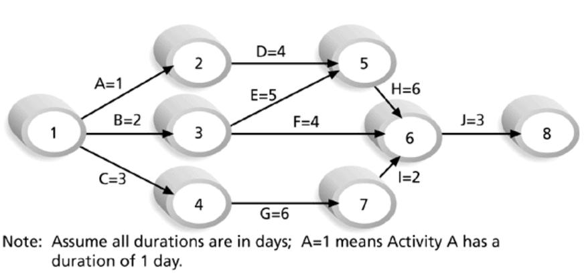
Sample Activity-on-Arrow (AOA) Network Diagram for Project X

Slide 23
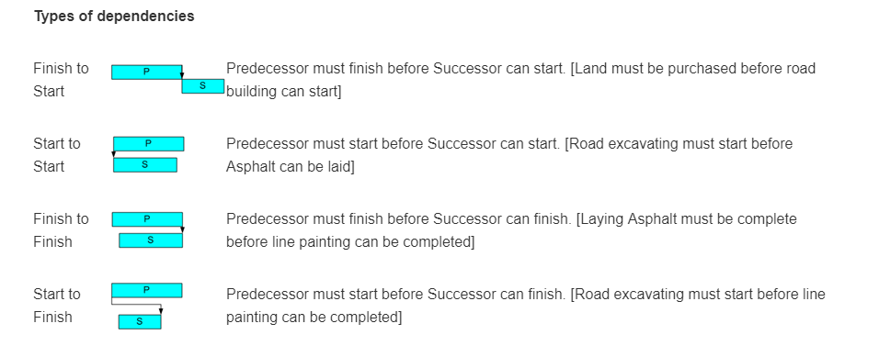
Task Dependency Types
Notes:
Dependencies are the relationships of the preceding tasks to the succeeding tasks. Tasks may have multiple preceding tasks and multiple succeeding tasks. The most common dependency relationship is a finish-to-start relationship. Task P (predecessor) must be finished before task S (successor) can start. The least common relationship is the start-to-finish relationship. Project Insight, project management software, supports all four dependency relationships.
asphalt

Slide 24
Precedence Diagramming Method (PDM)
Activities are represented by boxes.
Arrows show relationships between activities.
More popular than ADM method and used by project management software.
Better at showing different types of dependencies.

Slide 25
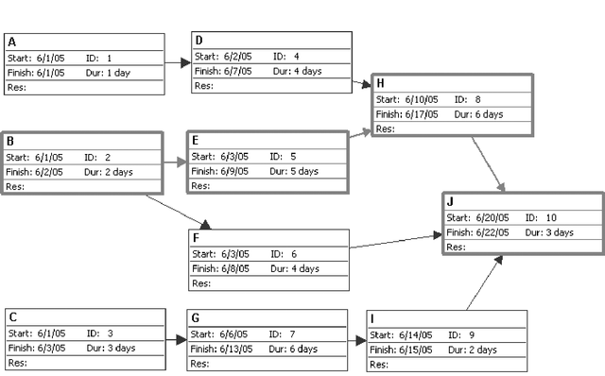
Sample PDM (Precedence Diagramming Method) Network Diagram

Slide 26
Activity Resource Estimating
Before estimating activity durations, you must have a good idea of the quantity and type of resources that will be assigned to each activity.
Consider important issues in estimating resources:
How difficult will it be to complete specific activities on this project?
What is the organization’s history in doing similar activities?
Are the required resources available?

Slide 27
Activity Duration Estimating
Duration includes the actual amount of time worked on an activity plus the elapsed time.
Effort is the number of workdays or work hours required to complete a task.
People doing the work should help create estimates, and an expert should review them.

Slide 28
Multi(Three) Point Estimating
Instead of providing activity estimates as a discrete number, such as four weeks, it’s often helpful to create a three-point estimate:
An estimate that includes an optimistic, most likely, and pessimistic estimate, such as three weeks for the optimistic, four weeks for the most likely, and five weeks for the pessimistic estimate.
Three-point estimates are needed for PERT estimates

Slide 29
Reserve Time
A reserve time is a percentage of the project duration or a preset number of work periods and is usually added to the end of the project schedule.
Reserve time may also be added to individual activity durations based on risk or uncertainty in the activity duration. When activities are completed late, the additional time for the activity is subtracted from the reserve time.
As the project moves forward, the reserve time can be reduced or eliminated as the project manager sees fit.
Reserve time decisions should be documented.

Slide 30
Schedule Development
Uses results of the other time management processes to determine the start and end dates of the project.
Ultimate goal is to create a realistic project schedule that provides a basis for monitoring project progress for the time dimension of the project.
Important tools and techniques include Gantt charts, critical path analysis, critical chain scheduling, and PERT analysis.

Slide 31
Schedule Development(contd.)
To develop a schedule, one needs to
Define the activities (WBS),
Put them in order of how the work will be done (activity sequencing), and then
Estimate the duration of each activity (activity duration estimating).

Slide 32
Critical Path Method (CPM)
CPM is a network diagramming technique used to predict total project duration.
The critical path is the longest path through the network diagram and has the least amount of slack or float.
Notes:
A critical path for a project is the series of activities that determines the earliest time by which the project can be completed.
Slack or float is the amount of time an activity can be delayed without delaying a succeeding activity or the project finish date.

Slide 33
Calculating the Critical Path
Develop a good network diagram.
Add the duration estimates for all activities on each path through the network diagram.
The longest path is the critical path.
If one or more of the activities on the critical path takes longer than planned, the whole project schedule will slip unless the project manager takes corrective action.

Slide 34
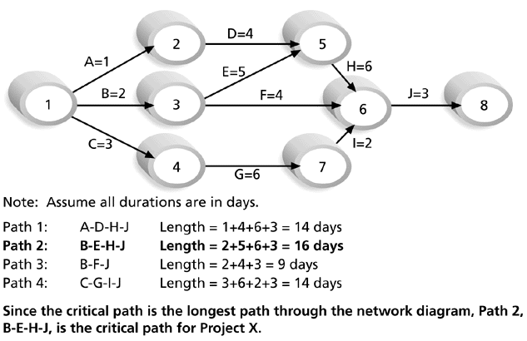
Figure 6-8. Determining the Critical Path for Project X

Slide 35
How to Find the Critical Path
To find the critical path, need to determine the following quantities for each activity in the network
Earliest start time (ES): the earliest time an activity can begin without violation of immediate predecessor requirements
Earliest finish time (EF): the earliest time at which an activity can end
Latest start time (LS): the latest time an activity can begin without delaying the entire project
Latest finish time (LF): the latest time an activity can end without delaying the entire project

Slide 36
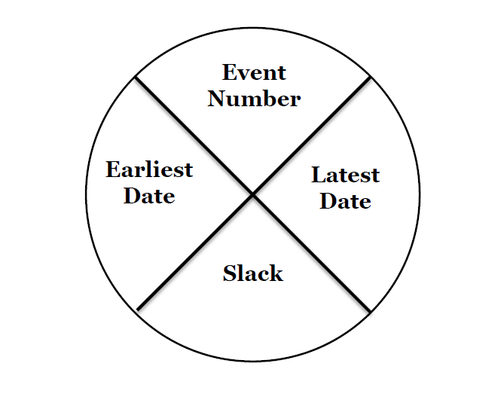
Activity Labelling

Slide 37
The Forward Pass Rule
The earliest date for an event is the earliest finish date for all the activities terminating at the event.
Where more than one activity terminates at a common event we take the latest of the earliest finish dates for those activities

Slide 38
The Backward Pass Rule
The latest date for an event is the latest start date for all the activities that may commence from that event.
Where more than one activity commences at a common event, we take the earliest of the latest start dates for those activities.

Slide 39
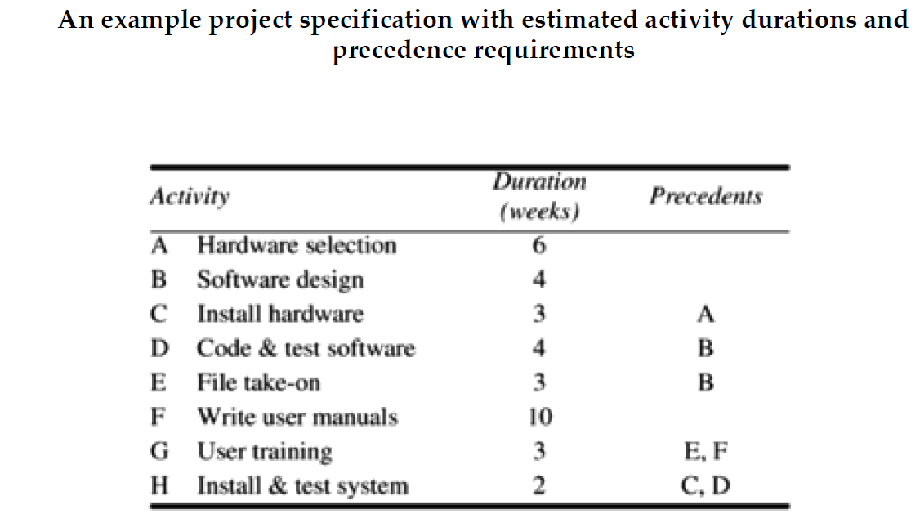
example!!!!!!

Slide 40
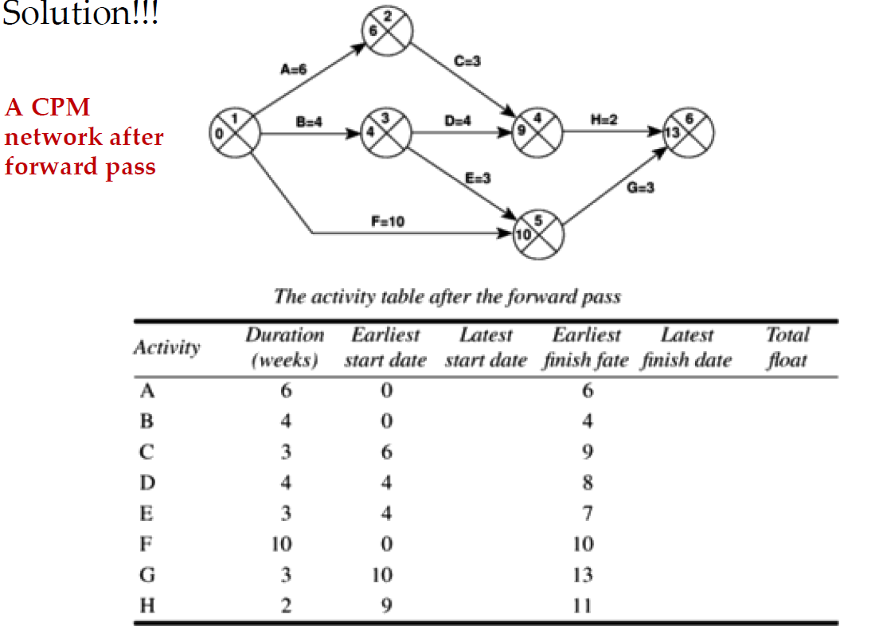

Slide 41
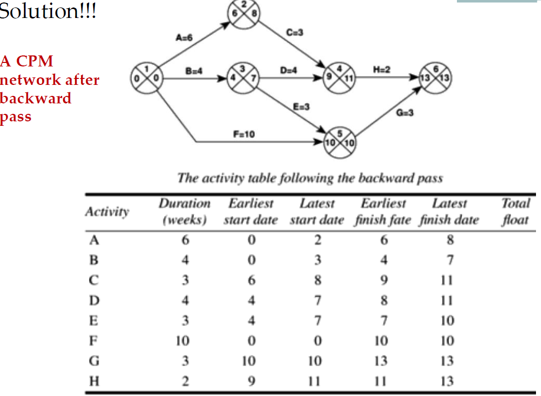

Slide 42
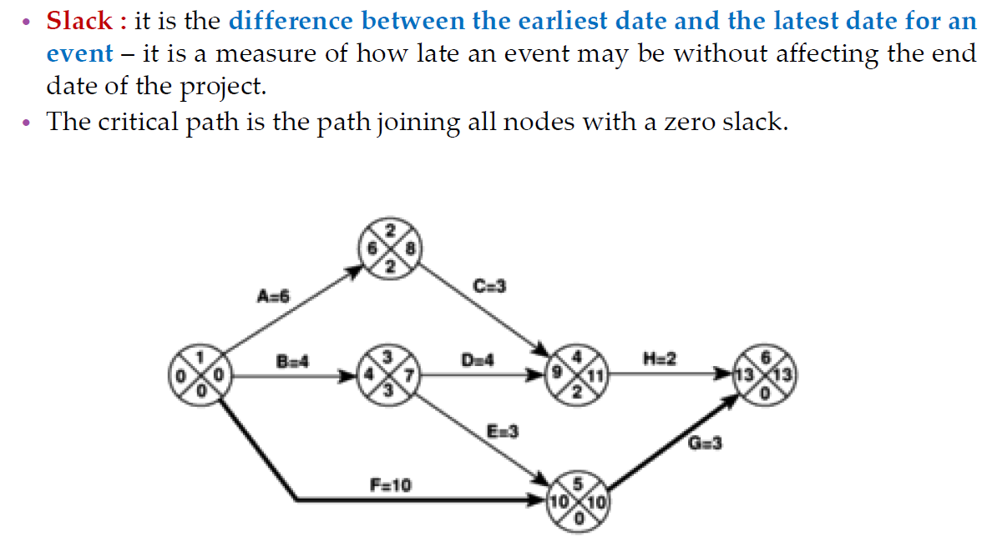
Identifying the critical path

Slide 43
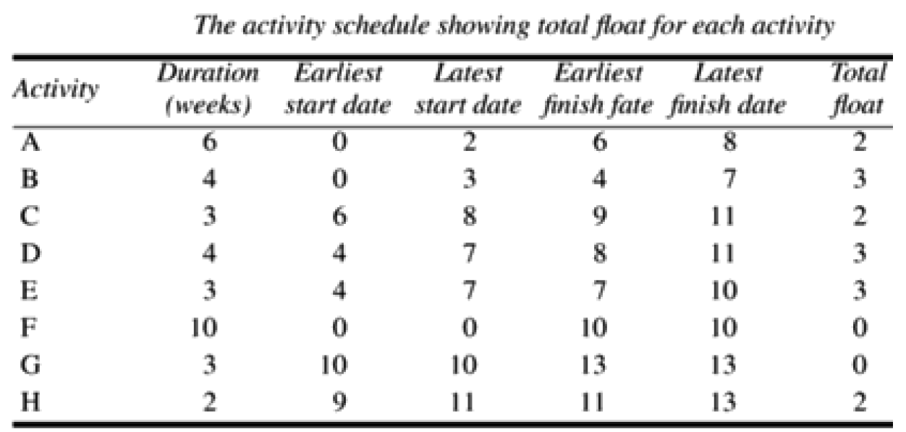
Identifying the critical path

Slide 44
Critical Path Method: An Example

Slide 45
Using Critical Path Analysis to Make Schedule Trade-offs
Free slack or free float is the amount of time an activity can be delayed without delaying the early start of any immediately following activities.
Total slack or total float is the amount of time an activity can be delayed from its early start without delaying the planned project finish date.
A forward pass through the network diagram determines the early start and finish dates.
A backward pass determines the late start and finish dates.

Slide 46
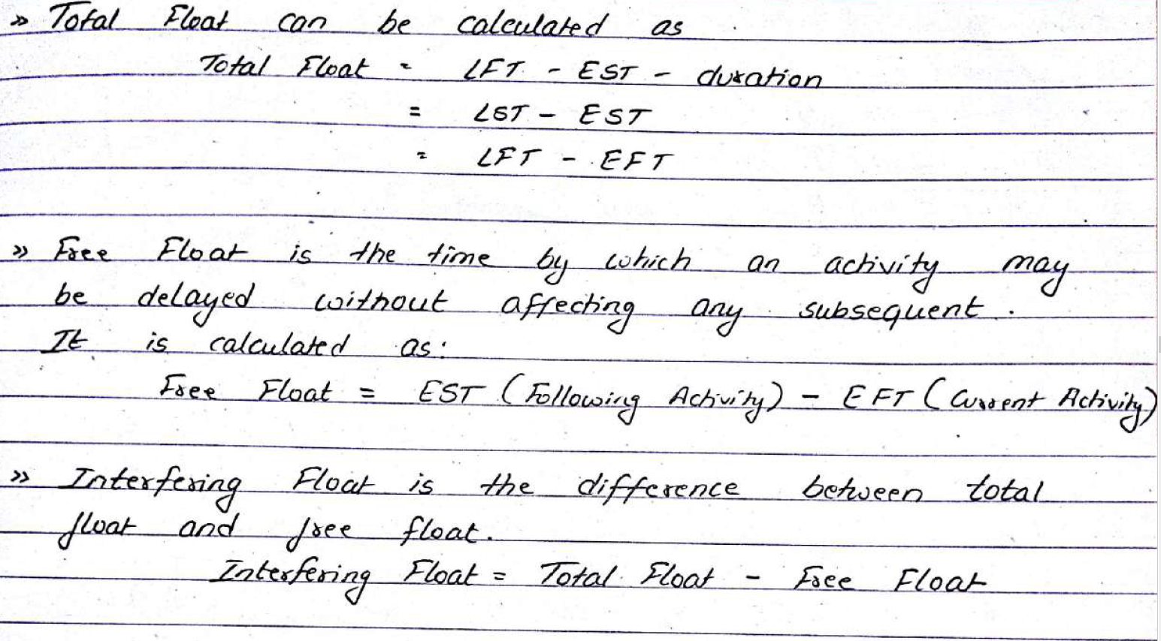

Slide 47
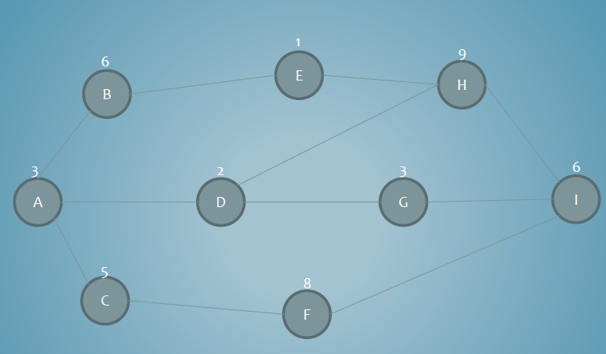
AON- Find the cp, tf and ff

Slide 48
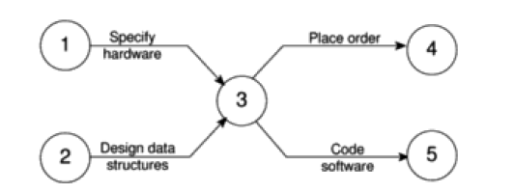
Dummy Activities
When two paths within a network have a common event although they are in other respects independent, a logical error such as that illustrated in Figure might occur

Slide 49

Suppose that. in a particular project it is necessary to specify a certain piece of hardware before placing an order for it and before coding the software.
Before coding the software it is also necessary to specify the appropriate data structures. although clearly we do not need to wait for this to be done before the hardware is ordered.
Notes:
Figure is an attempt to model the situation described above. Although it is incorrect in that it requires both hardware specification and data structure design to be completed before either an order may be placed or software coding may commence.

Slide 50
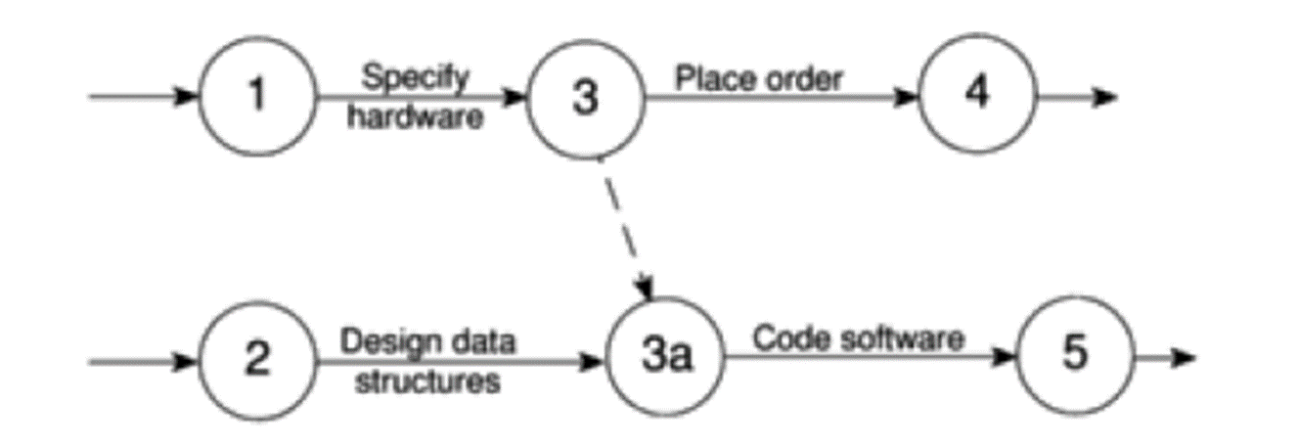
We can resolve this problem by separating the two (more or less) independent paths and introducing a dummy activity to link the completion of data structure design to the start of the activity placing an order. This effectively breaks the link between data structure design and placing the order and is shown in Figure

Slide 51

Dummy Activities have no duration and use no resources.
They are often used to aid in the layout of network drawings as in Figure
The use of a dummy activity where two activities share the same start and end nodes makes it easier to distinguish the activity end-points.

Slide 52
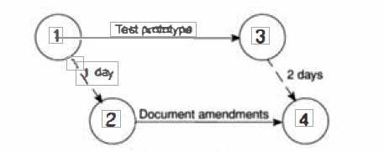
Lags and Leads
We might come across situations where we wished to undertake two activities in parallel so long as there is a Lag between the two.
We might wish to document amendments to a program as it was being tested - particularly if evaluating a prototype. ln such a case we could designate an activity test and document amendments’.
This would, however, make it impossible to show amendment recording starting after testing had begun and finishing a little after the completion of testing.

Slide 53
Lags
Lag refers to a relationship whereby the successor activity cannot start right after the end of its predecessor.
For example, after you’ve baked the cake, you might want to serve it cold.
Therefore, before serving it to the guests you will need to put the cake into a fridge and wait for it to cool.
This means that the activity “Serve Guests Cake" will not start right after its predecessor “Insert the Dish into the Oven." There is a delay. This delay is called Lag.

Slide 54
Leads
Lead refers to a relationship whereby the successor activity begins before the predecessor activity has completed.
For example, suppose you are baking a cake. As part of this, you will need to get the mixture ready and insert the dish into the oven.
“Get the Mixture Ready" is the predecessor of “Insert the Dish into the Oven." Pre-heat the oven is a task that is a part of the “Insert the Dish into the Oven" activity.
Therefore, the “Insert the Dish into the Oven" activity should start before you’ve completed the “Get the Mixture Ready" activity.
Assuming the pre-heating takes 20 minutes, then the “Insert the Dish into the Oven" activity should start 20 minutes before you have completed the “Get the Mixture Ready" activity. Therefore, the “Insert the Dish into the Oven" activity has Lead of 20 minutes.
Notes:
LEADS=NEGATIVE LAGS

Slide 55
Gantt charts
Gantt charts provide a standard format for displaying project schedule information by listing project activities and their corresponding start and finish dates in a calendar format.

Slide 56
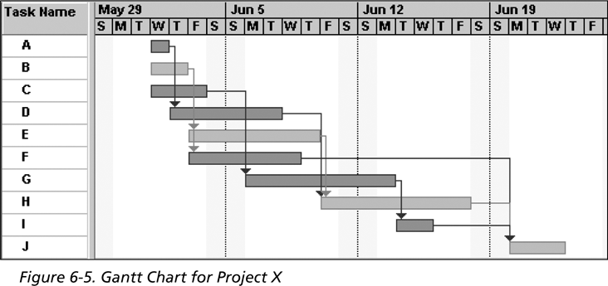
Figure . Gantt Chart for Project X
Note: In Project 2003 darker bars are red to represent critical tasks.

Slide 57
Adding Milestones to Gantt Charts
Many people like to focus on meeting milestones, especially for large projects.
Milestones emphasize important events or accomplishments in projects.
Notes:
You typically create milestone by entering tasks that have a zero duration, or you can mark any task as a milestone.

Slide 58
Program Evaluation Review Technique (PERT)

Slide 59
PERT
The optimistic time estimate (Ote)
The pessimistic time estimate (Pte)
The most likely time estimate (Mlte)
Expected time (Te)

Slide 60
Example
tell me:
if every thing progress as you expect, say in complete ideal situation how long it will take?
if every thing goes wrong and encountered unexpected situations, say in worst condition how long it will take? And
in carrying out such work what would be the normal duration?

Slide 61
Expected time
Te = Ote + 4Mlte + Pte
6

Slide 62
Let’s say:
in first case, the time required would be to weeks
in second case 34 weeks, and
in third 16 weeks.

Slide 63
The Expected Time
to + (4 x 16) + 34
te = 6
= 27 weeks

Slide 64
Critical Path Method: An Example

Slide 65
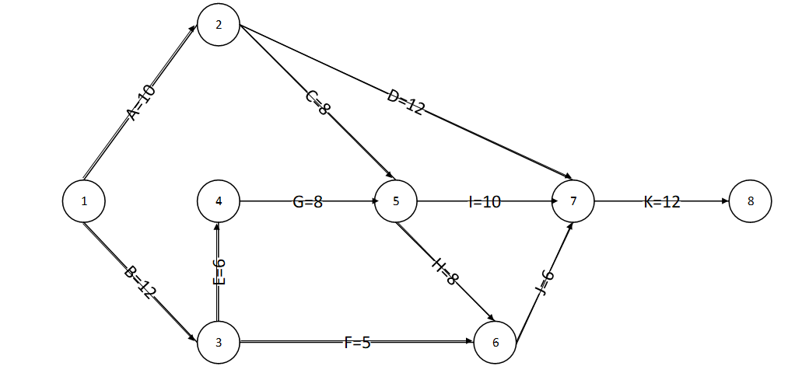
Network Table
Activity | D | ES (Tei) | EF | LS | LF (TLj) | TF (LS-ES) | FF=EF(succeed)-EF
1-2(A) | 10
1-3(B) | 12
2-5(C) | 8
2-7(D) | 12
3-4(E) | 6
3-6(F) | 5
4-5(G) | 8
5-6(H) | 8
5-7(I) | 10
6-7(J) | 6
7-8(K) | 12

Slide 66
Network Table
Activity (i-j) | D | ES (Tei) [Max of all in forward pass] | EF | LS | LF (TLj) [Min of all in backward pass] | TF (LS-ES) | FF= ES(succeed)-EF
1-2(A) | 10 | 0 |  |  | 10
1-3(B) | 12 | 0 |  |  | 12
2-5(C) | 8 | 10 |  |  | 26
2-7(D) | 12 | 10 |  |  | 40
3-4(E) | 6 | 12 |  |  | 18
3-6(F) | 5 | 12 |  |  | 34
4-5(G) | 8 | 18 |  |  | 26
5-6(H) | 8 | 26 |  |  | 34
5-7(I) | 10 | 26 |  |  | 40
6-7(J) | 6 | 34 |  |  | 40
7-8(K) | 12 | 40 |  |  | 52

Slide 67
Network Table
Activity | D tij | ES (Tei) | EF Tei+D | LS Tlj-tij | LF (TLj) | TF (LS-ES) | FF=ES(succeed)-EF
1-2(A) | 10 | 0 | 10 | 8 | 18
1-3(B) | 12 | 0 | 12 | 0 | 12
2-5(C) | 8 | 10 | 18 | 18 | 26
2-7(D) | 12 | 10 | 22 | 28 | 40
3-4(E) | 6 | 12 | 18 | 12 | 18
3-6(F) | 5 | 12 | 17 | 29 | 34
4-5(G) | 8 | 18 | 26 | 18 | 26
5-6(H) | 8 | 26 | 34 | 26 | 34
5-7(I) | 10 | 26 | 36 | 30 | 40
6-7(J) | 6 | 34 | 40 | 34 | 40
7-8(K) | 12 | 40 | 52 | 40 | 52

Slide 68
Network Table
Activity | D tij | ES (Tei) | EF Tei+D | LS Tlj-tij | LF (TLj) | TF (LS-ES) | FF=ES(succeed)-EF
1-2(A) | 10 | 0 | 10 | 8 | 18 | 8
1-3(B) | 12 | 0 | 12 | 0 | 12 | 0
2-5(C) | 8 | 10 | 18 | 18 | 26 | 8
2-7(D) | 12 | 10 | 22 | 28 | 40 | 18
3-4(E) | 6 | 12 | 18 | 12 | 18 | 0
3-6(F) | 5 | 12 | 17 | 29 | 34 | 17
4-5(G) | 8 | 18 | 26 | 18 | 26 | 0
5-6(H) | 8 | 26 | 34 | 26 | 34 | 0
5-7(I) | 10 | 26 | 36 | 30 | 40 | 4
6-7(J) | 6 | 34 | 40 | 34 | 40 | 0
7-8(K) | 12 | 40 | 52 | 40 | 52 | 0

Slide 69
Network Table
Activity | D tij | ES (Tei) | EF Tei+D | LS Tlj-tij | LF (TLj) | TF (LS-ES) | FF=ES(succeed)-EF
1-2(A) | 10 | 0 | 10 | 8 | 18 | 8 | 0
1-3(B) | 12 | 0 | 12 | 0 | 12 | 0 | 0
2-5(C) | 8 | 10 | 18 | 18 | 26 | 8 | 8
2-7(D) | 12 | 10 | 22 | 28 | 40 | 18 | 18
3-4(E) | 6 | 12 | 18 | 12 | 18 | 0 | 0
3-6(F) | 5 | 12 | 17 | 29 | 34 | 17 | 17
4-5(G) | 8 | 18 | 26 | 18 | 26 | 0 | 0
5-6(H) | 8 | 26 | 34 | 26 | 34 | 0 | 0
5-7(I) | 10 | 26 | 36 | 30 | 40 | 4 | 4
6-7(J) | 6 | 34 | 40 | 34 | 40 | 0 | 0
7-8(K) | 12 | 40 | 52 | 40 | 52 | 0 | 0

Slide 70
Thank you

